Slide 1
Python Libraries

Slide 2
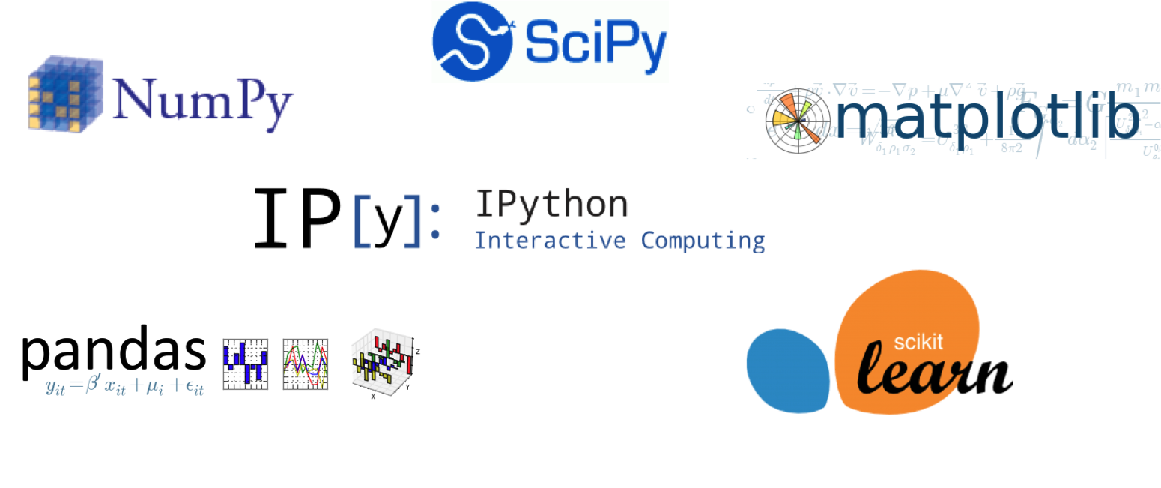

Slide 3

NumPy – Numeric Python
NumPy Features
NumPy operations
Mathematical and logical operations on arrays.
Fourier transforms and routines for shape manipulation.
Operations related to linear algebra.
Open Source
Array Processing
Data science & Scientific computation
Memory efficient
Handle vast amount of data
Standard python does not come with NumPy package.
NumPy Installation
Notes :
1. It is used as a replacement of MATLAB with SciPy and Mat−plotlib

Slide 4
NumPy Array - ND Array
A NumPy array is a grid of values, all of the same type, and is indexed by Zero based.
Ways to Create ND Array
zeroes(shape)
ones(shape)
eye(shape)
empty(shape)
arange(shape)
reshape(shape)
random.rand(shape)
Rank
The number of dimensions is the rank of the array;
Shape
Shape of an array is a tuple of integers giving the size of the array along each dimension.
For a 1D array, the shape would be (n,) where n is the number of elements in your array.
For a multidimensional array, the shape would be (n,m) where n is the number of rows and m is the number of columns in your array.

Slide 5
ND Array Introduction

Slide 6
Pandas

